Slide 1

EXCEL & SQL
End Term Project
“OKHAI”
Date of Submission – 16th Aug 2024

Slide 2

OKHAI: Sustainable Fashion for Women and Children
Okhai, an online startup specializing in occasion wear, is dedicated to empowering women and children through its commitment to sustainability and ethical fashion. With a brand vision of offering eco-friendly, handcrafted garments that celebrate India's cultural heritage, Okhai aims to bridge the gap between traditional craftsmanship and modern style.

Slide 3
Brand Mission: Positive Impact Through Sustainable Fashion
1
Sustainability
Okhai prioritizes sustainability to reduce its environmental footprint, using eco-friendly materials and production methods.
2
Empowering Artisans
The brand supports local artisans, fostering a sense of community and preserving traditional craftsmanship.
3
Ethical Fashion
Okhai offers high-quality, handcrafted occasion wear that celebrates India's cultural heritage.

Slide 4
Targeting Environmentally Conscious Consumers
Target Audience
Brand Appeal
Market Position
Okhai targets women and parents who seek stylish, ethical, and sustainable fashion choices. These consumers value transparency, quality, and the story behind the products they purchase.
Okhai appeals to individuals who appreciate unique, handcrafted designs and are mindful of their environmental impact. The brand also targets those who prioritize supporting small businesses and artisans.
In a market saturated with fast fashion, Okhai stands out as a champion of slow fashion and sustainability, offering customers an opportunity to make a positive impact with their purchasing decisions.

Slide 5

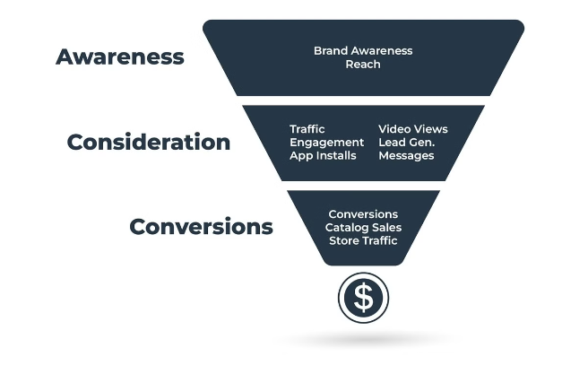
Advertising Campaign Objectives
1
Increase Brand Awareness
The campaign aims to raise awareness about Okhai's commitment to sustainable fashion and its unique product offerings.
2
Drive Online Traffic
The campaign seeks to drive more visitors to Okhai's online store, leveraging digital marketing and social media platforms.
3
Boost Sales
The ultimate goal of the campaign is to increase sales of Okhai's new collection of sustainable occasion wear for women and children.

Slide 6
Key Performance Indicators
Advertising Budget: The campaign budget should not exceed INR 100,000 to remain within the board's financial constraints.
Minimum Ad Placements: A minimum of 15 ads should be utilized across each chosen media channel to maximize campaign reach and visibility.
Criteria for Choosing Number of Ads for Different Media: The number of online ads should be at least as great as the number of print ads.

Slide 7

Advertising Budget and Constraints
Budget
INR 100,000
Minimum Online Ads
15
Minimum Print Ads
15
Online Ad Cost
INR 300 per ad
Print Ad Cost
INR 800 per ad
Online Ad Reach
5,000 people per ad
Print Ad Reach
10,000 people per ad

Slide 8

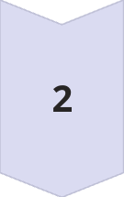

Optimizing the Advertising Channel Mix
Objective
Maximize the total reach of the advertising campaign while adhering to the budget and other constraints.
Solver Recommendation
The optimal channel mix is 293 online ads and 15 print ads, which will maximize the total reach while staying within the budget.
Actionable Insights
The ads manager should choose 293 online ads and 15 print ads to achieve the maximum reach while respecting the given constraints.

Slide 9
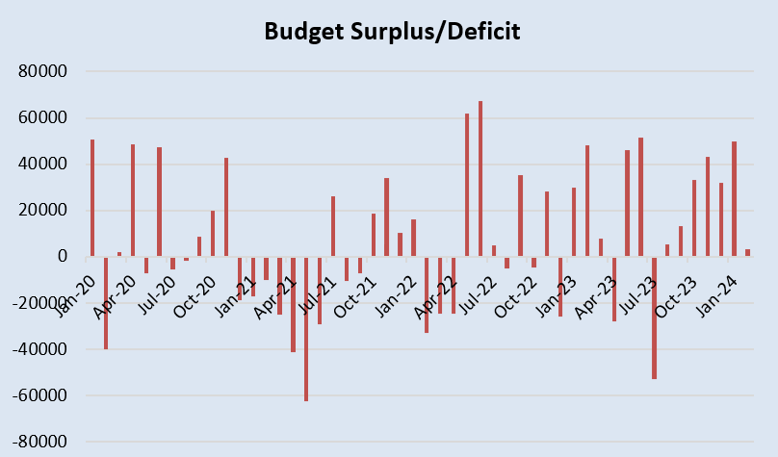
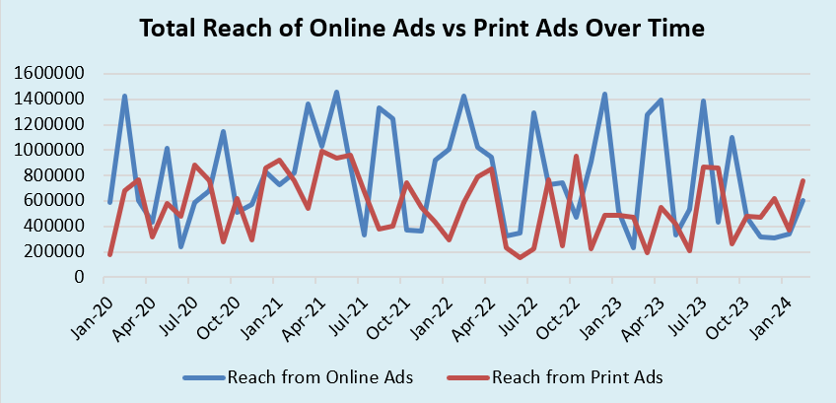
Visualizing the Data
Budget Surplus & Deficit
Reach Comparison
The chart shows the advertising budget, highlighting the budget surplus and deficit
The graph compares the total reach of online and print ads, demonstrating the effectiveness of the recommended channel mix.

Slide 10
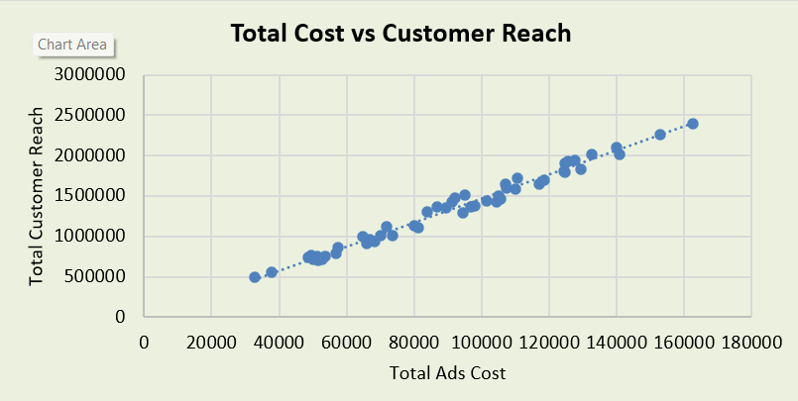
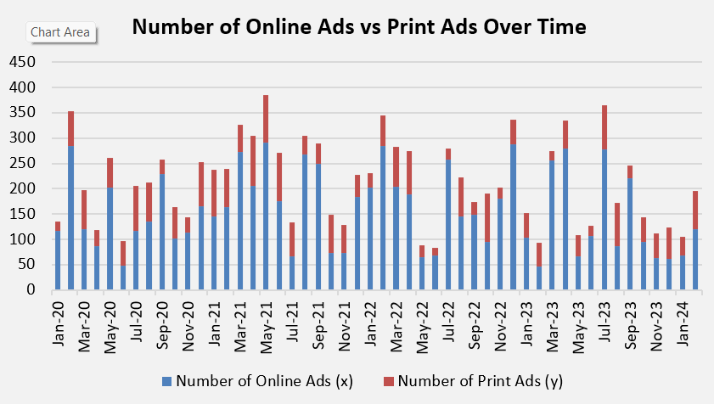
Visualizing the Data
Ads Cost vs Customer Reach
Ads Count over Time
The chart shows the comparison of total Advertisement cost and Total customer Reach
The graph depicts the total number of online and print ads over the span of 4 years

Slide 11
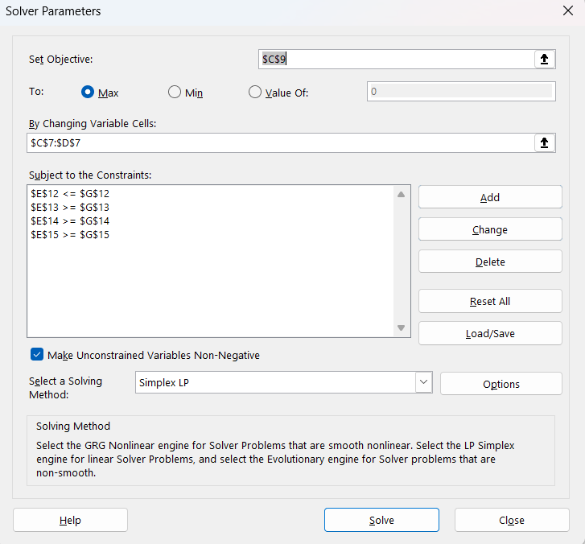
PROBLEM SOLVING WITH SOLVER
Create cell for variable data (ads for online &print)
Create a objective function (max people reach)
Create constraint table based on provided KPIs.
Input above data in solver.
Run the solver to get recommendation and generate reports.

Slide 12
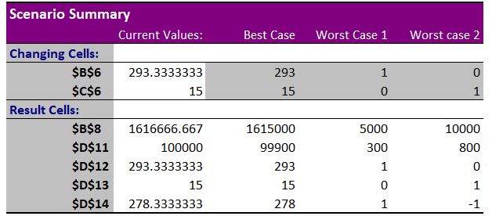
What If Analysis (Scenario Manager) Summary

Slide 13

Database Recommendations
Query Examples
Query : Total cost and reach from online ads
SELECT SUM([Total Cost]) AS Total_Cost_Online_Ads, SUM([Reach from Online Ads]) AS Total_Reach_Online_Ads FROM AdvertisingData
WHERE [Number of Online Ads (x)] > 0;
Database Design
Based on the provided dataset, SQL is recommended for managing the data related to the advertising campaign.
Query: Total cost and reach from print ads
SELECT SUM([Total Cost]) AS Total_Cost_Print_Ads, SUM([Reach from Print Ads]) AS Total_Reach_Print_Ads FROM AdvertisingData
WHERE [Number of Print Ads (y)] > 0;
Query Examples
The report includes sample SQL queries to calculate the total cost and reach for online and print ads, as well as the best scenario based on combined reach per cost.

Slide 14


Optimal Channel Mix
Conclusion
The ads manager should choose 293 online ads and 15 print ads to maximize reach while adhering to the budget constraints.
Based on the solution recommended through our analysis, it should run 293 online ads and 15 print ads. This is an optimal combination for it respects the budget constraints given to it while maximizing reach and effectiveness for the campaign.
This will ensure that the new collection by Okhai gets good, wide-reaching publicity across all digital media channels, which are much more potent from a reach and targeting perspective as compared to print ads. Limited usage of print ads will help in keeping the associated costs under control while providing some form of coverage in print media.
By this recommendation, Okhai can achieve its promotional goals more efficiently and smartly while balancing cost-effectiveness with campaign impact.

